Slide 1
Memory Layout AP
User Guide
Jack Su
20081111

Slide 2
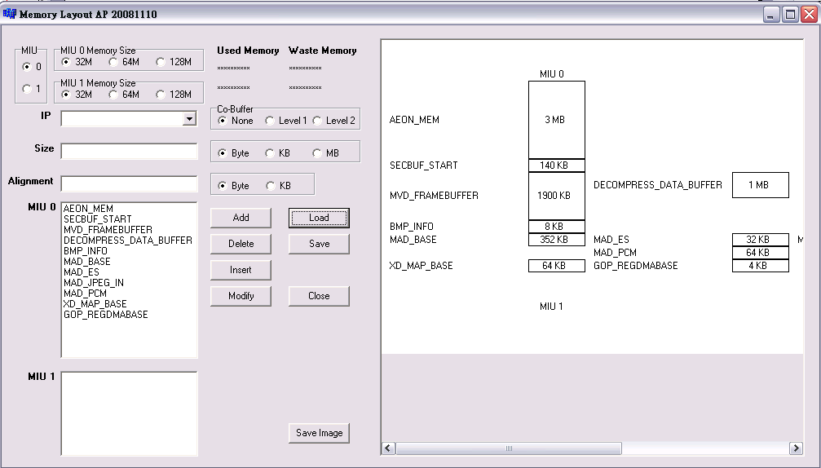
Set MIU 0 and MIU 1 memory size
Image Area
Choose MIU number
ListBox
Control Buttons

Slide 3
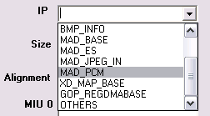
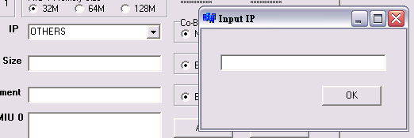

How to input “IP” column
Select combo-box items
Select “OTHERS” will show an input windows,
and then you can Key-in data
Key-in IP directly in the IP column
Select combo-box items
Select “OHERS” item,
and input IP in the windows
Key-in IP directly

Slide 4
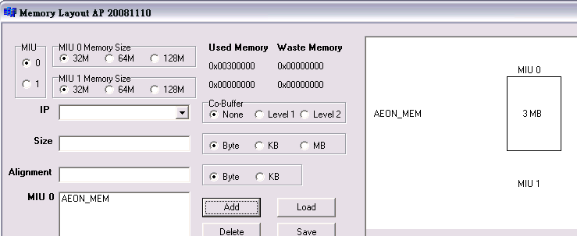
Add
Choose MIU which you want add IP.
Input IP, Size, Alignment, and choose the related options
(Co-Buffer, Byte, KB, MB).
Push the “Add” Button.
Then the IP will be add into ListBox.
The Image Area will show the IPs.
Show the IPs
IP is added into ListBox

Slide 5
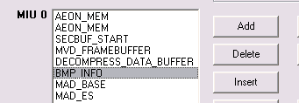

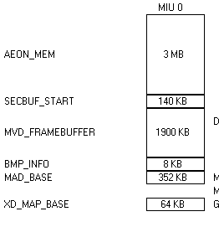
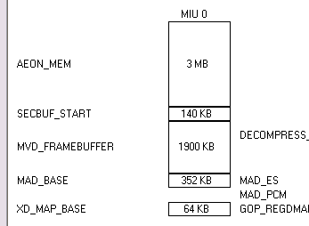
Delete
Select the IP in the ListBox that you want to delete.
Push the “Delete” button.
The Image Area will also change the newest state.

Slide 6
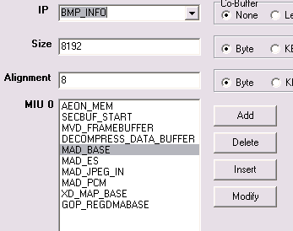
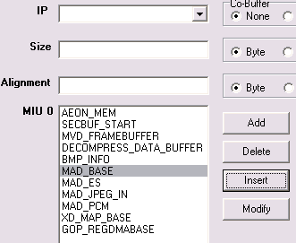
Insert
Select the IP in the ListBox that you want to insert before.
and input the new IP info.
Push the “Insert” button.
The Image Area will also change the newest state.
ex. Insert BMP_INFO before MAD_BASE

Slide 7
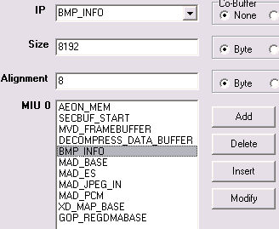
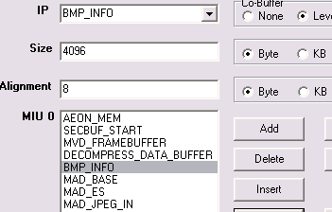
Modify
Select the IP that you want to modify.
The upper column will show the IP info.
Change the info (ex. Size, Align, Co-buffer),
and the push “Modify” button.
ex. Modify BMP_INFO Size and Co-Buffer

Slide 8
Load and Save
Load
  Read back created file
Save
  Output memory layout result to .h file
Save Image
  Output the image to .bmp file

